Slide 1

INFORMATIONAL INTERVIEW & NETWORKING PLAN
ASSIGNMENT 2
JAMIE LU | NOVEMBER 2020

Slide 2

Agenda
INTRODUCTION
THE INTERVIEW
CAREER GOAL
THE PLAN

Slide 3

INTRODUCTION
WHAT IS THIS?
TASK: conduct an informational interview of an IT professional and develop a professional networking and development plan.
The following presentation contains the insights and results of the task done.

Slide 4

The interview
Let’s Dive In

Slide 5
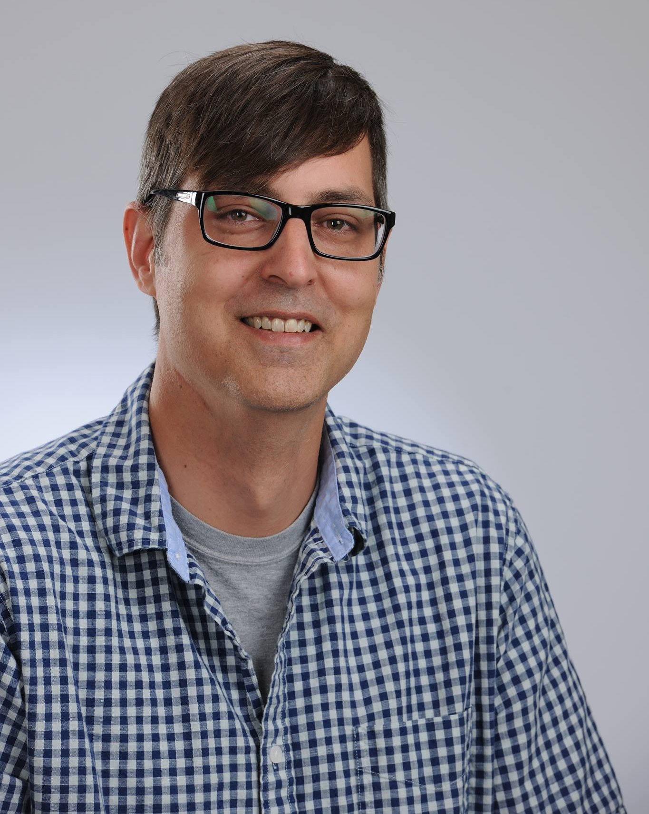
Meet Bruno roy
OCCUPATION:
SRI TECHNICAL ADMINISTRATOR, DALHOUSIE UNIVERSITY
TYPE OF EDUCATION:
BUSINESS ADMINISTRATION

Slide 6

WHY BRUNO?

Slide 7

Challenges faced?
“Education did not fully prepare me for my IT career”
Successes?
“Turned a student job into a career by working hard and learning as many IT skills as possible.”
Knowledge, Skills, Abilities?
System Administration,
Database Administration,
Software and desktop support,
HTML and website content creation,
Management and training

Slide 8

CONCLUSIONS
TOP 3 PROFESSIONAL QUALITIES:
Good Communication Skills
Great Management Skills
Life-long learner
INSIGHTS ABOUT CAREER PATH
You have to do continued professional development whenever possible in order to increase/sharpen your skills

Slide 9
-Bruno roy, sri technical administrator, Dalhousie university
“There is no substitute for hard work. Working well with others and developing skills specific to the job are important and will help you move forward in your career.”

Slide 10

Career goal
LOOKING AHEAD

Slide 11
PROFESSIONAL history
UNIVERSITY OF SAN CARLOS - PHILIPPINES |  |  | TIM HORTONS |  |  | ARDENE |  |  | NOVA DISCOUNT HUB
JUN 2013 | - | MAR 2016 | APR 2016 | - | MAY 2016 | JUN 2016 | - | JULY 2016 | JUL 2016 | - | APR 2017
STUDENT OF POLITICAL SCIENCE, MAJOR IN LAW AND POLICY STUDIES, MINOR IN ECONOMICS |  |  | TIM HORTONS Worked very well with co-workers and had positive feedback from customers |  |  | SALES ASSOCIATE Efficiently and effectively organized inventory |  |  | SALES ASSOCIATE organized products on the shelf strategically to increase sales received positive feedback from managers

Slide 12
PROFESSIONAL history
NOVA DISCOUNT HUB |  |  | BBW INTERNATIONAL |  |  | HGS CANADA |  |  | PENHORN MEDICAL CLINIC
APR 2017 | - | JAN 2020 | SEPT 2018 | - | SEPT 2019 | SEPT 2018 | - | SEPT 2019 | FEB 2020 | - | SEPT 2020
ASSISTANT MANAGER Created posts on Facebook page to boost sales Increased workplace efficiency by creating floor plans, and daily tasks Received positive feedback from staff and owners Organized price lists, scheduled promotions to boost sales Created invoices for wholesale customers Kept track of inventory to make sure shelves were always restocked and which items are selling Organized inventory to increase restocking efficiency by up to 20% |  |  | EVENT STAFF Received very positive feedback from multiple organizers Listened and helped attendees with questions and inquiries Organized the necessary resources for each event |  |  | CUSTOMER SERVICE REPRESENTATIVE Received multiple positive feedback from customers and supervisors Awarded as the Top of Class during training Boosted sales and maintained top score card with score of 1.1 overall Helped customers with their issues and inquiries, as well as, analyzed accounts for any errors and troubleshoot them |  |  | MEDICAL OFFICE SECRETARY Increased profit by booking appointments to keep doctor’s schedule full Received positive feedback for being a fast learner and for attention to detail Received positive feedback from patients for being organized, timely and always following up and keeping track.

Slide 13
PROFESSIONAL history
NOVA SCOTIA COMMUNITY COLLEGE | BBW INTERNATIONAL | HGS CANADA |  |  | PENHORN MEDICAL CLINIC
SEPTEMBER | 2020 |  | - |  | PRESENT
STUDENT, IT DATABASE ADMINISTRATION
SKILLS MS SQL Server, SQLite MariaDB Data Management and Data Engineering Data Gathering and Analysis Object Oriented Programming using Java Website Development using HTML and CSS Microsoft Office 365 Suite Logic and Programming using Python Metadata Management Data Fundamentals Transactional Database Programming Essentials of Business Analysis Networking and Security Small Business Infrastructures Data Security Linux Operating Systems Data Management, Analysis, and Visualizations | EVENT STAFF •Received very positive feedback from multiple organizers •Listened and helped attendees with questions and inquiries •Organized the necessary resources for each event | SCHOOL PROJECTS NRC Data Collection Project Created a network design for an ER Registration System application that helps reduce wait times in the ER Created a battleship game using Python Created a card game using Java Created an IOT design for a multi-mirror Developed a website using HTML and CSS ERD to get ideas on what causes the overflow of patients in hospitals and possible ways of resolving the issue Console program used in retail organizations to calculate shipping and total costs Work Plan video presentation that received a perfect mark and offer to show video to more students and faculty |  |  | MEDICAL OFFICE SECRETARY •Increased profit by booking appointments to keep doctor’s schedule full •Received positive feedback for being a fast learner and for attention to detail •Received positive feedback from patients for being organized, timely and always following up and keeping track.

Slide 14





Key strengths
TEAM PLAYER
ORGANIZED
ANALYTICAL
INNOVATIVE

Slide 15

Career:
database administrator
Securing the performance, integrity, and security of a database. Planning and developing the database and dealing with issues by the users of the database
Notes:
Referenced from: A.G.C.A.S. (2020, January). Database administrator job profile | Prospects.ac.uk. Prospects. https://www.prospects.ac.uk/job-profiles/database-administrator

Slide 16

Key skill areas
Communication
Information/Data Management
Problem Solving
Active in projects
Team player
Adaptable
Responsible
Life-long learner
Notes:
Referenced from: C. (n.d.). Employability Skills. Retrieved November 05, 2020, from https://www.conferenceboard.ca/edu/employability-skills.aspx?AspxAutoDetectCookieSupport=1

Slide 17

Connecting the dots
MY
QUALITIES
Being organized and efficient is very helpful in information and data management. Being able to visualize how you can manage raw data and organize it in a meaningful way that is not only helpful to other IT professionals but also to any other data user.
Since the world is advancing, the way we look at data and how we manage it, should too. Being innovative is helpful with regards to this because you think outside the box. There are endless possibilities.
Being a team player is important because as a database administrator, you have to deal with different people, whether these are people that come from the same field or not. As a database administrator, you have to know how to be inclusive, open minded, and respectful of other people in order to succeed.
There are going to be situations wherein a DBA has to troubleshoot or see how to fix the database or make it better, having an analytical mind is great in problem solving scenarios like these.
CHOSEN CAREER
Notes:
Referenced from: C. (n.d.). Employability Skills. Retrieved November 05, 2020, from https://www.conferenceboard.ca/edu/employability-skills.aspx?AspxAutoDetectCookieSupport=1

Slide 18

The plan
WHAT NEEDS TO BE DEVELOPED
I NEED TO DEVELOP MY IT SKILLS.
This will be done continuously even after I graduate from my program.
I ALSO NEED TO DEVELOP MORE CONFIDENCE IN SPEAKING TO NEW PEOPLE.
This can be done through practice and trying my best to meet new people.
WHAT SHOULD I BE INVOLVED IN?
GROUPS RELATED TO MY CAREER PATH AND INTERESTS
Join facebook, linkedin, and other social media groups online that are related to IT, my career path, and my interests
CAREER FAIRS
Join career fairs to be able to meet new people and expand my network.
COMPETITIONS, EVENTS
- Be active and join competitions, events or forums to stay updated in the IT World and be able to meet new people, and enrich my mind with new ideas
Notes:
It’s important to join groups that interest you, even if they don’t directly relate to your career/field. You never know, you might be able to merge your IT skills and your interests.

Slide 19



THANK YOU
JAMIE LU
W0441213
w0441213@nscc.ca
IT DBA - 2

